Slide 1
SFIA Project
Amogh Naik

Slide 2
Contents
Introduction
My Journey through QA
Application
Demo
Testing
CI Pipeline
Future Improvements
Conclusion

Slide 3
Introduction
Aims of the project:
Create a web application with CRUD functionality.
Test the application.
Integrate the project with a CI pipeline.
Produce thorough documentation for all of the above.
How did I achieve these aims?

Slide 4
My journey through QA
Week 1 – Project Management, Documentation.
Week 2 – SQL databases, GCP.
Week 3 – Python coding and testing.
Week 4 – Jenkins, Flask.
Week 5 – Flask, Testing, Deployment.

Slide 5
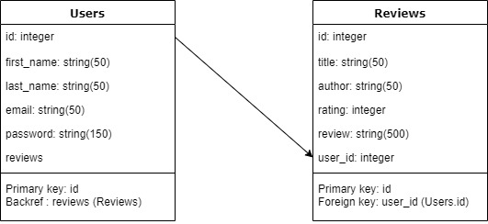
Application
Book review application.
Users can read and post reviews.
Users and Reviews tables with a many-to-one relationship.
Full CRUD functionality on both tables – users can edit their reviews and their account information.

Slide 6
Demo
See the application in action!

Slide 7
Testing
Used pytest to test application.
Used pytest-cov to generate a coverage report of 56%.
Coverage: platform linux, python 3.5.3-final-0 -----------
Name Stmts Miss Cover
---------------------------------------------
application/__init__.py 13 0 100%
application/forms.py 49 7 86%
application/models.py 22 2 91%
application/routes.py 106 74 30%
---------------------------------------------
TOTAL 190 83 56%
========== 9 passed, 4 warnings in 1.54s ==========

Slide 8
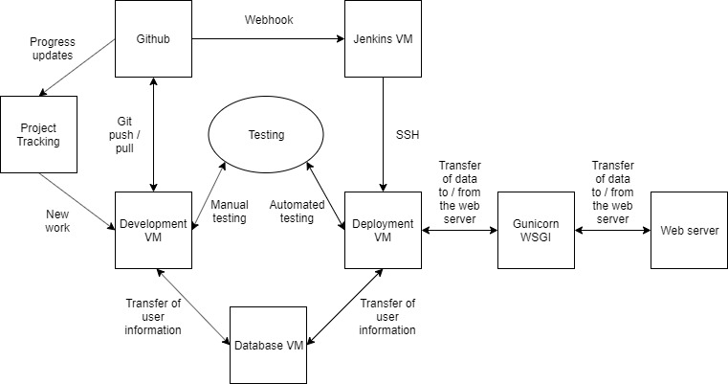
CI Pipeline

Slide 9
Future Improvements
Selenium testing to improve test coverage.
Bootstrap to improve website design.

Slide 10
Conclusion
Made a web application allowing users to view book reviews and submit their own reviews.
Made Users and Reviews tables with full CRUD functionality on both.
Ran tests and achieved 56% coverage.
Implemented a CI pipeline including Github and Jenkins.
In the future, I would incorporate Selenium testing and Bootstrap.
View my full repository, including documentation, at https://github.com/devops-cohort/amogh.git

